Slide 1


Recipe Traffic Prediction Analysis
This presentation outlines a comprehensive analysis to predict recipe popularity on Tasty Bytes' website. Our goal is to enhance user web traffic by accurately identifying high-traffic recipes.
by Anyanwu Justice
A

Slide 2


Table of Contents
1
Introduction
2
Dataset Overview
3
Methodology
4
Exploratory Data Analysis
5
Model Selection
6
Model Performance Comparison
7
Business Metrics
8
Business Recommendations

Slide 3

Introduction
Tasty Bytes was founded in 2020 in the midst of the Covid Pandemic. We started life as a search engine for recipes, helping people to find ways to use up the limited supplies they had at home. From previous observations, a popular recipe on the homepage can increase website traffic by as much as 40%. More traffic leads to more subscriptions, so this is really important.
Business Goal
- The primary business goal is to predict which recipes will generate high traffic on Tasty Bytes' website. This prediction will help optimize content strategy.
- The secondary business goal is to accurately identify high-traffic recipes 80% of the time, ensuring the right content is promoted to users on the homepage of their website.

Slide 4




Dataset Overview
Total Recipes: 947
Features
The dataset contains information on 947 unique recipes, providing a substantial base for analysis.
Key features include nutritional values (calories, fat, protein), recipe category (e.g., dessert, main course), and servings.
Target Variable
Dataset Source
The target variable is high_Traffic, which is marked as high when a recipe generates high traffic.
The data is sourced directly from Tasty Bytes, ensuring relevance and accuracy for the analysis.

Slide 5





Methodology
Data Cleaning and Validation
- Removed missing data to ensure data integrity.
- Ensured all data types were consistent and appropriate for analysis
Exploratory Data Analysis and Statistical Testing
Carried out an intensive analysis to identify what features make a
Recipe to generate high traffic.
Machine Learning Techniques
Built various machine learning models to predict which recipes generate the most traffic.
Evaluated and compared models’ performance
Business Metrics and Recommendations
Identified key business metrics and gave recommendations based on findings.

Slide 6
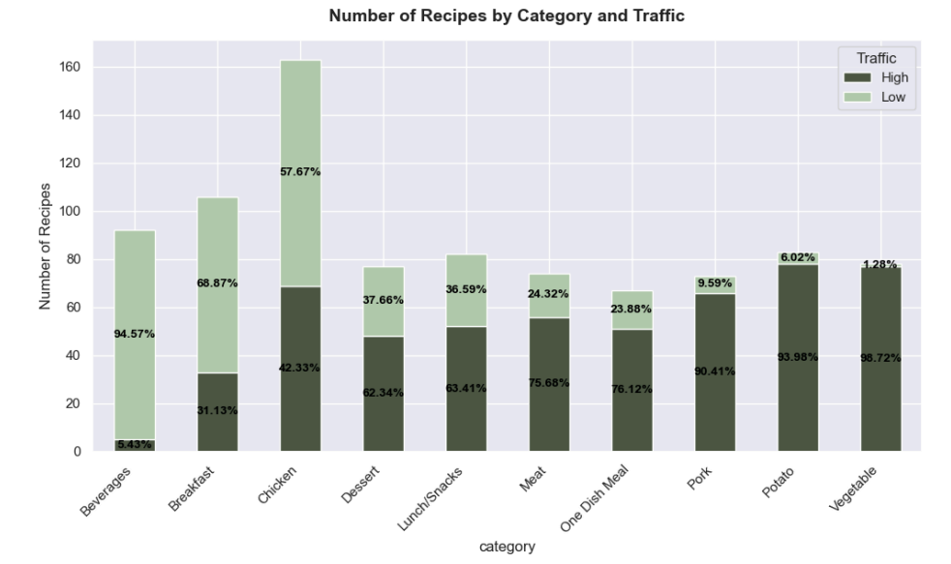

Exploratory Data Analysis

Slide 7
Model Selection
Baseline Model: Dummy Classifier/Naïve Classifier
Random Forest Classifier
Logistic Regression
This model predicts the majority class, serving as a baseline for evaluating the performance of more complex models.
Used for its robustness and ability to capture
non-linear relationships, while also providing
feature importance insights.
Chosen for its interpretability and good performance, making it suitable for understanding feature importance.

Slide 8
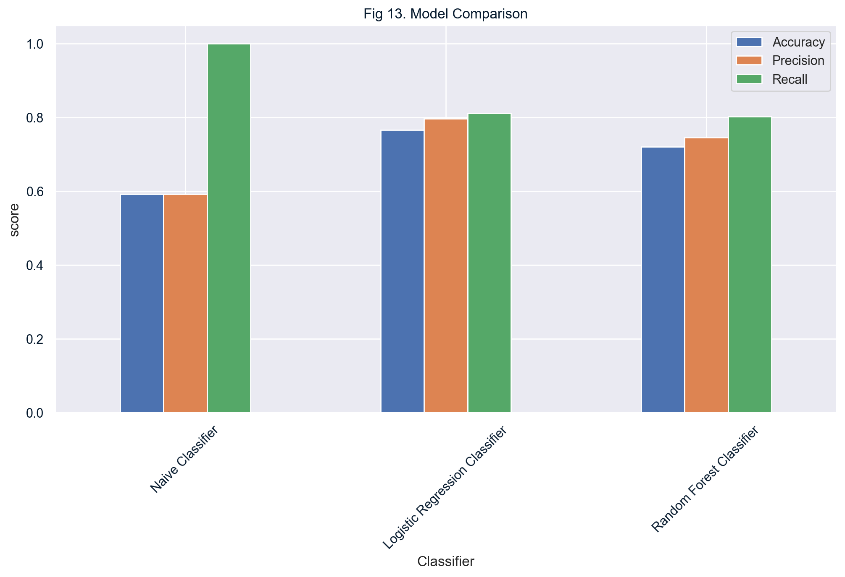



Model Performance Comparison
Best Model: Logistic Regression
Logistic Regression emerged as the best model due to its balanced performance.
Balanced Recall and Precision
It offers a good balance between recall and precision, making it reliable for
identifying high-traffic recipes.
Ensures Correct Identification
Ensures that most high-traffic recipes are correctly identified, minimizing
false negatives.

Slide 9



Business Metrics
These metrics provide a clear understanding of the impact of our model on business outcomes and guide strategic decision-making. By focusing on these metrics, we can align our efforts with business goals.
2
Result
From data collected, the business has a 60% Recipe Popularity Rate.
Recipe Popularity Rate
Calculated as (High-Traffic Recipes / Total Recipes) * 100.
1
Limitations
There is no clear threshold for defining 'high traffic', requiring further refinement.
3

Slide 10
Business Recommendations
Data Acquisition
1
Incorporate more detailed data on user interactions, such as time spent on a recipe, clicks, shares, and ratings.
Promoting High Traffic Recipe Categories
2
Promoting recipes from categories such as "Vegetable," "Potato," and "Pork," which show a higher association with high-traffic recipes.
Model Deployment
3
Deploying the Logistic Regression model to accurately identify high traffic recipes.
Constant Re-training of Model on new data
4
Retrain the model regularly with updated data to account for changing user preferences, considering factors like seasonality and trending topics that impact recipe popularity.
Monitoring of Model Predictions.
5
Continuously monitor model performance in real-time and adjust predictions as needed.

